Slide 1

EVOLUTION OF DEVOPS AND AGILE
Presented by
Aishwarya V
Indhuja Natchiyar M
Kavya Rakshitha V

Slide 2

INTRODUCTION
Software development has evolved significantly from traditional waterfall methods to Agile and DevOps. Agile introduced flexibility and iterative development, while DevOps emphasized automation and collaboration. The combination of Agile And Devops has transformed how businesses develop, test, and deploy software.

Slide 3


The Birth of DevOps (2009)
Why Agile Needed DevOps?
Agile improved software development but didn’t address deployment challenges.
DevOps emerged to bridge the gap between development (Dev) and operations (Ops).

Slide 4

Core DevOps Principles
Continuous Integration (CI): Automating code integration into a shared repository.
Continuous Deployment (CD): Automating software release cycles.
Automation: Using tools for infrastructure management and testing.
Collaboration: Breaking silos between teams.

Slide 5

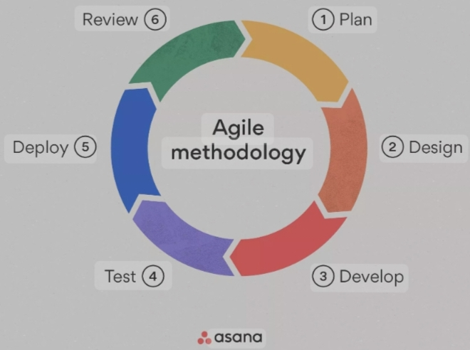
What is Agile?
Agile is a software development methodology focused on iterative progress, collaboration, and customer feedback.
Key Agile Methodologies:
Scrum: Time-boxed sprints for rapid delivery.
Kanban: Visualizing workflow and limiting work in progress.

Slide 6

The Evolution of DevOps
2010s: Rise of CI/CD Pipelines:
Tools like Jenkins, GitLab CI/CD, and GitHub Actions gained popularity.
2015: DevSecOps - Integrating Security:
Shift-left approach: Integrating security early in development.
2020s: AI & ML in DevOps (AIOps, NoOps):
AI-powered monitoring, self-healing systems, and predictive analytics.

Slide 7

Key Technologies Driving DevOps
CI/CD Tools: Jenkins, GitHub Actions, GitLab CI/CD.
Infrastructure as Code (IaC): Terraform, Ansible, AWS CloudFormation.
Cloud & Containerization: Docker, Kubernetes, AWS, Azure, Google Cloud.
Monitoring & Logging: Prometheus, Grafana, ELK Stack.

Slide 8


The Future of Agile & DevOps
AI-powered DevOps (AIOps): Predictive analytics for proactive issue resolution.
NoOps: Automation removing the need for dedicated Ops teams.
BizDevOps: Aligning business, development, and operations teams for end-to-end collaboration.

Slide 9


Case Studies
Netflix – DevOps for Rapid Deployments
Uses microservices architecture and CI/CD pipelines.
Deploys thousands of changes per day without downtime.
Automated testing and self-healing infrastructure.
Spotify – Agile and DevOps for Scalability
Uses “Squads” (small, independent Agile teams).
Implements DevOps principles for continuous delivery.
Deploys new features quickly while maintaining stability.

Slide 10
Conclusion
Agile introduced flexibility and collaboration in development. DevOps enhanced Agile by integrating automation, CI/CD, and infrastructure management. Future trends like AI, NoOps, and BizDevOps will further
transform software development. Combining Agile and DevOps is key to delivering high-quality software efficiently.

Slide 11


Slide 12


